Slide 1


Full Stack Developer - Python

Slide 2
Our Goal
Learn Python
Creating Windows Application
Creating Web Application
Database interaction to [ Add/ Edit & Delete and Reporting ]
Hosting of application

Slide 3
Python Installation

Slide 4
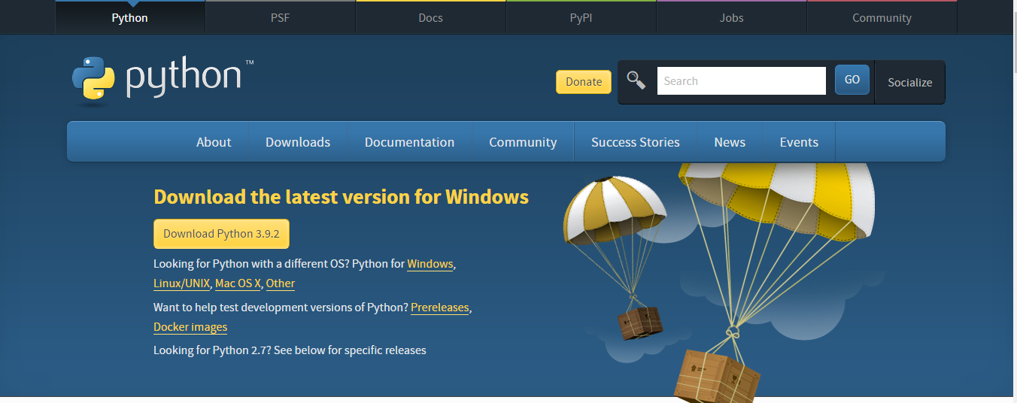
https://www.python.org/downloads/

Slide 5
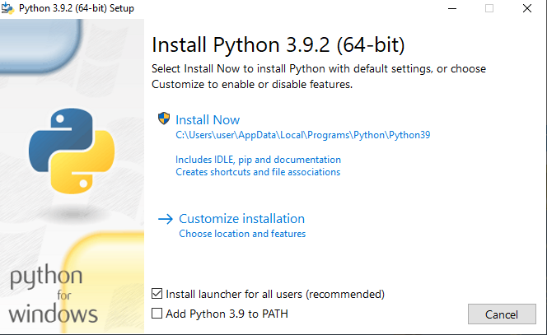

Slide 6
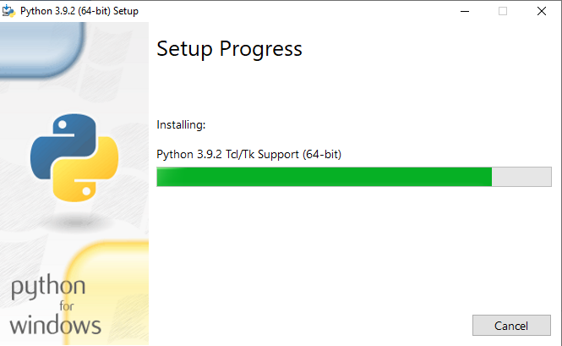

Slide 7
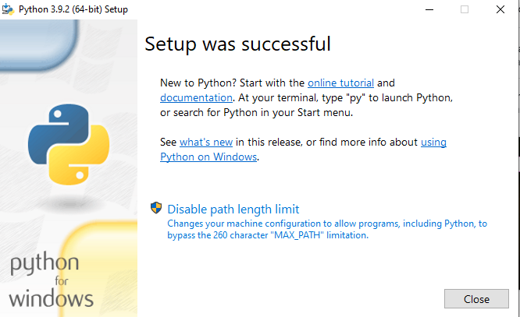

Slide 8
Visual Studio Code Installation

Slide 9
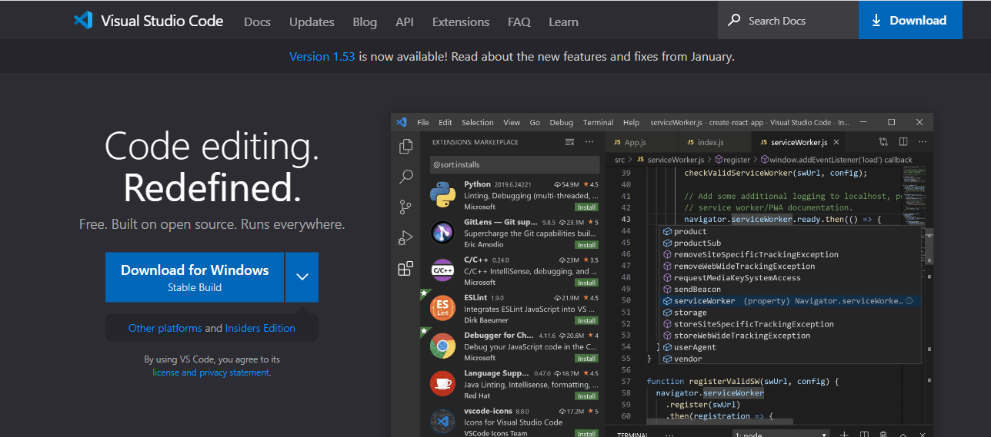
https://code.visualstudio.com/

Slide 10
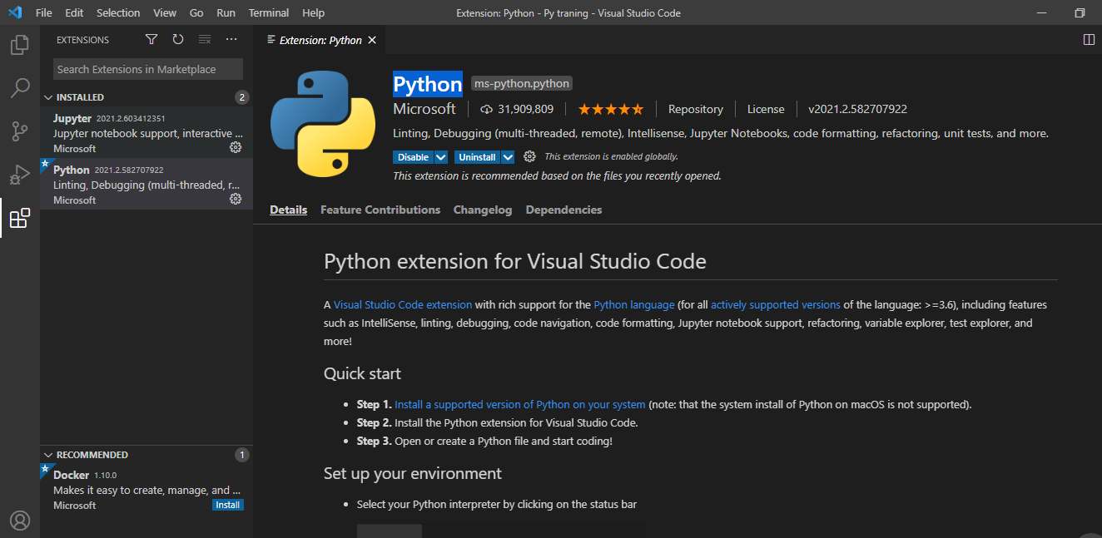
Extension Pythonms-python.python

